Slide 1
Assembly Language for Intel-Based Computers, 6th Edition
Kip Irvine
Chapter 3: Assembly Language Fundamentals
Slides prepared by the author
Revision date: June 4, 2006
(c) Pearson Education, 2006-2007. All rights reserved. You may modify and copy this slide show for your personal use, or for use in the classroom, as long as this copyright statement, the author's name, and the title are not changed.

Slide 2
Chapter Overview
Basic Elements of Assembly Language
Example: Adding and Subtracting Integers
Assembling, Linking, and Running Programs
Defining Data
Symbolic Constants
Irvine, Kip R. Assembly Language for Intel-Based Computers, 2007.

Slide 3
Basic Elements of Assembly Language
Integer constants
Integer expressions
Character and string constants
Reserved words and identifiers
Directives and instructions
Labels
Mnemonics and Operands
Comments
Examples
Irvine, Kip R. Assembly Language for Intel-Based Computers, 2007.

Slide 4
Integer Constants
Optional leading + or – sign
binary, decimal, hexadecimal, or octal digits
Common radix characters:
  h – hexadecimal
  d – decimal
  b – binary
  r – encoded real
Radix characters are not case sensitive
Examples: 30d, 6Ah, 42, 1101b
Hexadecimal beginning with letter: 0A5h
Irvine, Kip R. Assembly Language for Intel-Based Computers, 2007.

Slide 5
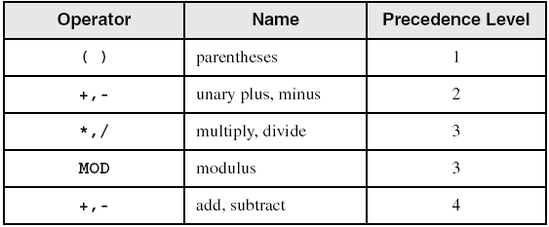
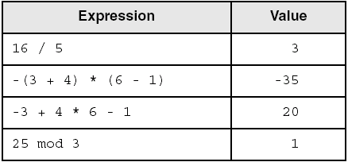
Integer Expressions
Operators and precedence levels:
Examples:
Irvine, Kip R. Assembly Language for Intel-Based Computers, 2007.

Slide 6
Character and String Constants
Enclose character in single or double quotes
  'A', "x"
  ASCII character = 1 byte
Enclose strings in single or double quotes
  "ABC"
  'xyz'
  Each character occupies a single byte
Embedded quotes:
  'Say "Goodnight," Gracie'
Irvine, Kip R. Assembly Language for Intel-Based Computers, 2007.

Slide 7
Reserved Words and Identifiers
Reserved words cannot be used as identifiers
  Instruction mnemonics, register names, directives, type attributes, operators, predefined symbols
  See MASM reference in Appendix A
Identifiers
  1-247 characters, including digits
  not case sensitive
  first character must be a letter, _, @, ?, or $
  cannot be the same as an assembler reserved word
Irvine, Kip R. Assembly Language for Intel-Based Computers, 2007.

Slide 8
Directives
Commands that are recognized and acted upon by the assembler
  Not part of the Intel instruction set
  Used to declare code, data areas, select memory model, declare procedures, etc.
  not case sensitive
Different assemblers have different directives
  NASM not the same as MASM, for example
Irvine, Kip R. Assembly Language for Intel-Based Computers, 2007.

Slide 9
Directives vs. Instructions
myVar DWORD 26 ; DWORD directive
mov eax,myVar ; MOV instruction
The DWORD directive tells the assembler to reserve space in the program for a doubleword variable.
The MOV instruction, on the other hand, executes at runtime, copying the contents of myVar to the EAX register
Irvine, Kip R. Assembly Language for Intel-Based Computers, 2007.

Slide 10
Instructions
Assembled into machine code by assembler
Executed at runtime by the CPU
We use the Intel IA-32 instruction set
An instruction contains:
  Label (optional)
  Mnemonic (required)
  Operand (depends on the instruction)
  Comment (optional)
Syntax:
  [label:] mnemonic [operands] [;comment]
Irvine, Kip R. Assembly Language for Intel-Based Computers, 2007.

Slide 11
Labels
Act as place markers
  marks the address (offset) of code and data
Follow identifier rules
Data label
  must be unique
  example: myArray DWORD 1, 2 (not followed by colon)
Code label
  target of jump and loop instructions
  example: target: (followed by colon)
  mov ax, bx
  …
  jmp target
Irvine, Kip R. Assembly Language for Intel-Based Computers, 2007.

Slide 12
Mnemonics and Operands
Instruction Mnemonics
  memory aid
  examples: MOV, ADD, SUB, MUL, INC, DEC
Operands
  constant
  constant expression
  register
  memory (data label)
Constants and constant expressions are often called immediate values
Irvine, Kip R. Assembly Language for Intel-Based Computers, 2007.

Slide 13
Comments
Comments are good!
  explain the program's purpose
  when it was written, and by whom
  revision information
  tricky coding techniques
  application-specific explanations
Single-line comments
  begin with semicolon (;)
Multi-line comments
  begin with COMMENT directive and a programmer-chosen character
  end with the same programmer-chosen character
Irvine, Kip R. Assembly Language for Intel-Based Computers, 2007.

Slide 14
Comments
Examples of multi-line comments:
Example1:
COMMENT !
This line is a comment.
This line is also a comment.
!
Example2 :
COMMENT &
This line is a comment.
This line is also a comment.
&
Irvine, Kip R. Assembly Language for Intel-Based Computers, 2007.

Slide 15
Instruction Format Examples
No operands
  stc ; set Carry flag
  nop ; do nothing, used to align code
One operand
  inc eax ; register
  inc myByte ; memory
Two operands
  add ebx,ecx ; register, register
  sub myByte,25 ; memory, constant
  add eax,36 * 25 ; register, constant-expression
Irvine, Kip R. Assembly Language for Intel-Based Computers, 2007.

Slide 16
What's Next
Basic Elements of Assembly Language
Example: Adding and Subtracting Integers
Assembling, Linking, and Running Programs
Defining Data
Symbolic Constants
Irvine, Kip R. Assembly Language for Intel-Based Computers, 2007.

Slide 17
Example: Adding and Subtracting Integers
TITLE Add and Subtract (AddSub.asm)
; This program adds and subtracts 32-bit integers.
INCLUDE Irvine32.inc
.code
main PROC
mov eax,10000h ; EAX = 10000h
add eax,40000h ; EAX = 50000h
sub eax,20000h ; EAX = 30000h
call DumpRegs ; display registers
exit
main ENDP
END main
Irvine, Kip R. Assembly Language for Intel-Based Computers, 2007.

Slide 18
Example Output
Program output, showing registers and flags:
EAX=00030000 EBX=7FFDF000 ECX=00000101 EDX=FFFFFFFF
ESI=00000000 EDI=00000000 EBP=0012FFF0 ESP=0012FFC4
EIP=00401024 EFL=00000206 CF=0 SF=0 ZF=0 OF=0
Irvine, Kip R. Assembly Language for Intel-Based Computers, 2007.

Slide 19
Suggested Coding Standards (1 of 2)
Some approaches to capitalization
  capitalize nothing
  capitalize everything
  capitalize all reserved words, including instruction mnemonics and register names
  capitalize only directives and operators
Other suggestions
  descriptive identifier names
  spaces surrounding arithmetic operators
  blank lines between procedures
Irvine, Kip R. Assembly Language for Intel-Based Computers, 2007.

Slide 20
Suggested Coding Standards (2 of 2)
Indentation and spacing
  code and data labels – no indentation
  executable instructions – indent 4-5 spaces
  comments: begin at column 40-45, aligned vertically
  1-3 spaces between instruction and its operands
    e.g.: mov ax,bx
  1-2 blank lines between procedures
Irvine, Kip R. Assembly Language for Intel-Based Computers, 2007.

Slide 21
Alternative Version of AddSub
TITLE Add and Subtract (AddSubAlt.asm)
; This program adds and subtracts 32-bit integers.
.386
.MODEL flat,stdcall
.STACK 4096
ExitProcess PROTO, dwExitCode:DWORD
DumpRegs PROTO
.code
main PROC
mov eax,10000h ; EAX = 10000h
add eax,40000h ; EAX = 50000h
sub eax,20000h ; EAX = 30000h
call DumpRegs
INVOKE ExitProcess,0
main ENDP
END main
Irvine, Kip R. Assembly Language for Intel-Based Computers, 2007.

Slide 22
Program Template
TITLE Program Template (Template.asm)
; Program Description:
; Author:
; Creation Date:
; Revisions:
; Date: Modified by:
INCLUDE Irvine32.inc
.data
; (insert variables here)
.code
main PROC
; (insert executable instructions here)
exit
main ENDP
; (insert additional procedures here)
END main
Instructors: please customize as needed
Irvine, Kip R. Assembly Language for Intel-Based Computers, 2007.

Slide 23
What's Next
Basic Elements of Assembly Language
Example: Adding and Subtracting Integers
Assembling, Linking, and Running Programs
Defining Data
Symbolic Constants
Irvine, Kip R. Assembly Language for Intel-Based Computers, 2007.

Slide 24
Assembling, Linking, and Running Programs
Assemble-Link-Execute Cycle
Listing File
Map File
Irvine, Kip R. Assembly Language for Intel-Based Computers, 2007.

Slide 25
Assemble-Link Execute Cycle
The following diagram describes the steps from creating a source program through executing the compiled program.
If the source code is modified, Steps 2 through 4 must be repeated.
Irvine, Kip R. Assembly Language for Intel-Based Computers, 2007.

Slide 26
Listing File
Use it to see how your program is compiled
Contains
  source code
  addresses
  object code (machine language)
  segment names
  symbols (variables, procedures, and constants)
Example
Irvine, Kip R. Assembly Language for Intel-Based Computers, 2007.

Slide 27
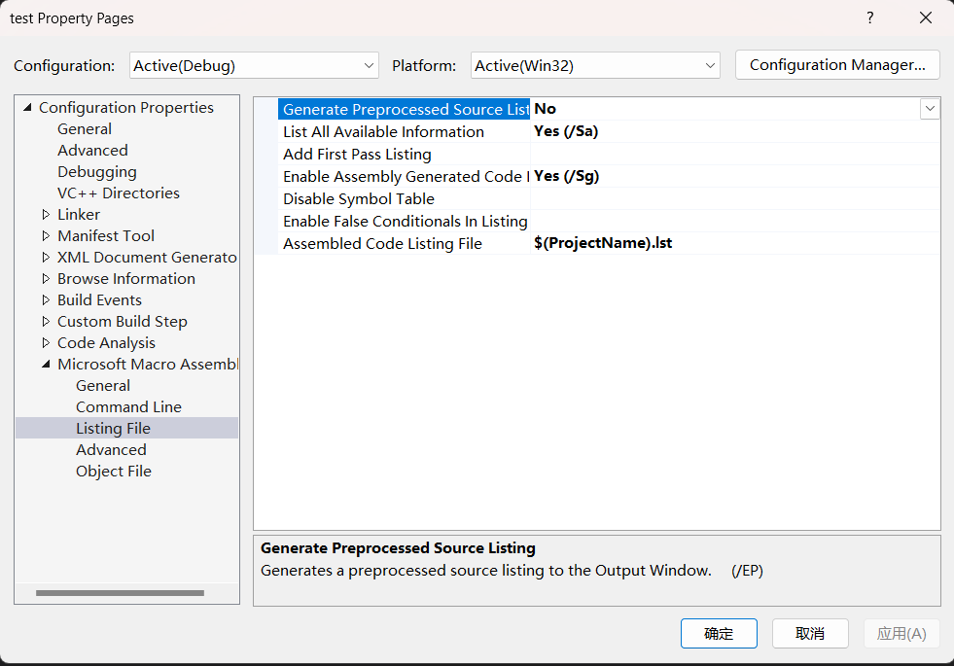
Configure Visual Studio
Irvine, Kip R. Assembly Language for Intel-Based Computers, 2007.

Slide 28

Map File
Information about each program segment:
  starting address
  ending address
  size
  segment type
Example: addSub.map (16-bit version)
Irvine, Kip R. Assembly Language for Intel-Based Computers, 2007.

Slide 29
What's Next
Basic Elements of Assembly Language
Example: Adding and Subtracting Integers
Assembling, Linking, and Running Programs
Defining Data
Symbolic Constants
Irvine, Kip R. Assembly Language for Intel-Based Computers, 2007.

Slide 30
Defining Data
Intrinsic Data Types
Data Definition Statement
Defining BYTE and SBYTE Data
Defining WORD and SWORD Data
Defining DWORD and SDWORD Data
Defining QWORD Data
Defining TBYTE Data
Defining Real Number Data
Little Endian Order
Adding Variables to the AddSub Program
Declaring Uninitialized Data
Irvine, Kip R. Assembly Language for Intel-Based Computers, 2007.

Slide 31
Intrinsic Data Types (1 of 2)
BYTE, SBYTE
  8-bit unsigned integer; 8-bit signed integer
WORD, SWORD
  16-bit unsigned & signed integer
DWORD, SDWORD
  32-bit unsigned & signed integer
QWORD
  64-bit integer
TBYTE
  80-bit integer
Irvine, Kip R. Assembly Language for Intel-Based Computers, 2007.

Slide 32
Intrinsic Data Types (2 of 2)
REAL4
  4-byte IEEE short real
REAL8
  8-byte IEEE long real
REAL10
  10-byte IEEE extended real
Irvine, Kip R. Assembly Language for Intel-Based Computers, 2007.

Slide 33
Legacy Data Directives
Directive | Usage
DB | 8-bit integer
DW | 16-bit integer
DD | 32-bit integer or real
DQ | 64-bit integer or real
DT | 80-bit (10-byte) integer
Irvine, Kip R. Assembly Language for Intel-Based Computers, 2007.

Slide 34
Data Definition Statement
A data definition statement sets aside storage in memory for a variable.
May optionally assign a name (label) to the data
Syntax:
  [name] directive initializer [,initializer] . . .
  value1 BYTE 10
All initializers become binary data in memory
Irvine, Kip R. Assembly Language for Intel-Based Computers, 2007.

Slide 35
Defining BYTE and SBYTE Data
Each of the following defines a single byte of storage:
value1 BYTE 'A' ; character constant
value2 BYTE 0 ; smallest unsigned byte
value3 BYTE 255 ; largest unsigned byte
value4 SBYTE -128 ; smallest signed byte
value5 SBYTE +127 ; largest signed byte
value6 BYTE ? ; uninitialized byte
MASM does not prevent you from initializing a BYTE with a negative value, but it's considered poor style.
If you declare a SBYTE variable, the Microsoft debugger will automatically display its value in decimal with a leading sign.
Irvine, Kip R. Assembly Language for Intel-Based Computers, 2007.

Slide 36
Defining Byte Arrays
Examples that use multiple initializers:
list1 BYTE 10,20,30,40
list2 BYTE 10,20,30,40
BYTE 50,60,70,80
BYTE 81,82,83,84
list3 BYTE ?,32,41h,00100010b
list4 BYTE 0Ah,20h,‘A’,22h
Irvine, Kip R. Assembly Language for Intel-Based Computers, 2007.

Slide 37
Defining Strings (1 of 3)
A string is implemented as an array of characters
  For convenience, it is usually enclosed in quotation marks
  It often will be null-terminated
Examples:
str1 BYTE "Enter your name",0
str2 BYTE 'Error: halting program',0
str3 BYTE 'A','E','I','O','U'
greeting BYTE "Welcome to the Encryption Demo program "
BYTE "created by Kip Irvine.",0
Irvine, Kip R. Assembly Language for Intel-Based Computers, 2007.

Slide 38
Defining Strings (2 of 3)
The line continuation character (\) concatenates two source code lines into a single statement. It must be the last character on the line.
To continue a single string across multiple lines, end each line with a comma:
menu \
BYTE "Checking Account",0dh,0ah,0dh,0ah,
"1. Create a new account",0dh,0ah,
"2. Open an existing account",0dh,0ah,
"3. Credit the account",0dh,0ah,
"4. Debit the account",0dh,0ah,
"5. Exit",0ah,0ah,
"Choice> ",0
Irvine, Kip R. Assembly Language for Intel-Based Computers, 2007.

Slide 39
Defining Strings (3 of 3)
End-of-line character sequence:
  0Dh = carriage return
  0Ah = line feed
str1 BYTE "Enter your name: ",0Dh,0Ah
BYTE "Enter your address: ",0
newLine BYTE 0Dh,0Ah,0
Idea: Define all strings used by your program in the same area of the data segment.
Irvine, Kip R. Assembly Language for Intel-Based Computers, 2007.

Slide 40
Using the DUP Operator
Use DUP to allocate (create space for) an array or string. Syntax: counter DUP ( argument )
Counter and argument must be constants or constant expressions
var1 BYTE 20 DUP(0) ; 20 bytes, all equal to zero
var2 BYTE 20 DUP(?) ; 20 bytes, uninitialized
var3 BYTE 4 DUP("STACK") ; 20 bytes: "STACKSTACKSTACKSTACK"
var4 BYTE 10,3 DUP(0),20 ; 5 bytes
Irvine, Kip R. Assembly Language for Intel-Based Computers, 2007.

Slide 41
Defining WORD and SWORD Data
Define storage for 16-bit integers
  or double characters
  single value or multiple values
word1 WORD 65535 ; largest unsigned value
word2 SWORD –32768 ; smallest signed value
word3 WORD ? ; uninitialized, unsigned
word4 WORD "AB" ; double characters
myList WORD 1,2,3,4,5 ; array of words
array WORD 5 DUP(?) ; uninitialized array
Irvine, Kip R. Assembly Language for Intel-Based Computers, 2007.

Slide 42
Defining DWORD and SDWORD Data
Storage definitions for signed and unsigned 32-bit integers:
val1 DWORD 12345678h ; unsigned
val2 SDWORD –2147483648 ; signed
val3 DWORD 20 DUP(?) ; unsigned array
val4 SDWORD –3,–2,–1,0,1 ; signed array
Irvine, Kip R. Assembly Language for Intel-Based Computers, 2007.

Slide 43
Defining QWORD, TBYTE, Real Data
Storage definitions for quadwords, tenbyte values, and real numbers:
quad1 QWORD 1234567812345678h
val1 TBYTE 1000000000123456789Ah
rVal1 REAL4 -2.1
rVal2 REAL8 3.2E-260
rVal3 REAL10 4.6E+4096
ShortArray REAL4 20 DUP(0.0)
Irvine, Kip R. Assembly Language for Intel-Based Computers, 2007.

Slide 44
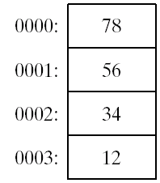
Little Endian Order
All data types larger than a byte store their individual bytes in reverse order. The least significant byte occurs at the first (lowest) memory address.
Example:
val1 DWORD 12345678h
0003
0002
0001
0000
12
34
56
78
Irvine, Kip R. Assembly Language for Intel-Based Computers, 2007.

Slide 45
Adding Variables to AddSub
TITLE Add and Subtract, Version 2 (AddSub2.asm)
; This program adds and subtracts 32-bit unsigned
; integers and stores the sum in a variable.
INCLUDE Irvine32.inc
.data
val1 DWORD 10000h
val2 DWORD 40000h
val3 DWORD 20000h
finalVal DWORD ?
.code
main PROC
mov eax,val1 ; start with 10000h
  add eax,val2 ; add 40000h
  sub eax,val3 ; subtract 20000h
  mov finalVal,eax ; store the result (30000h)
  call DumpRegs ; display the registers
  exit
main ENDP
END main
Irvine, Kip R. Assembly Language for Intel-Based Computers, 2007.

Slide 46
Declaring Unitialized Data
Use the .data? directive to declare an uninitialized data segment:
  .data?
Within the segment, declare variables with "?" initializers:
  smallArray DWORD 10 DUP(?)
Advantage: the program's EXE file size is reduced.
Disadvantage: the assembler will not report an error even if the segment declared by the .data? directive has initialized data
Irvine, Kip R. Assembly Language for Intel-Based Computers, 2007.

Slide 47
Mixing Code and Data (1 of 2)
The assembler lets you switch back and forth between code and data in your programs.
Data and code are placed separately by MASM even they appear to be mixed in source code.
Example1:
.data
smallArray DWORD 10 DUP(0) ; 40 bytes
.data?
bigArray DWORD 5000 DUP(?) ; 20,000 bytes, not initialized
Irvine, Kip R. Assembly Language for Intel-Based Computers, 2007.

Slide 48
Mixing Code and Data (2 of 2)
Example2:
.code
mov eax,ebx
.data
temp DWORD ?
.code
mov temp,eax
. . .
.data
temp DWORD ?
.code
mov eax,ebx
mov temp,eax
. . .
Equivalent
Irvine, Kip R. Assembly Language for Intel-Based Computers, 2007.

Slide 49
What's Next
Basic Elements of Assembly Language
Example: Adding and Subtracting Integers
Assembling, Linking, and Running Programs
Defining Data
Symbolic Constants
Irvine, Kip R. Assembly Language for Intel-Based Computers, 2007.

Slide 50
Symbolic Constants
Basic Concepts
Equal-Sign Directive
Calculating the Sizes of Arrays and Strings
EQU Directive
TEXTEQU Directive
Irvine, Kip R. Assembly Language for Intel-Based Computers, 2007.

Slide 51
Symbolic Constants
A symbolic constant (or symbol definition) is created by associating an identifier (a symbol) with an integer expression or some text.
Symbols do not reserve storage.
They are used only by the assembler when scanning a program, and they cannot change at runtime.
Irvine, Kip R. Assembly Language for Intel-Based Computers, 2007.

Slide 52
Equal-Sign Directive
name = expression
  expression is a 32-bit integer (expression or constant)
  may be redefined
  name is called a symbolic constant
good programming style to use symbols
COUNT = 500
.
.
mov al,COUNT
Irvine, Kip R. Assembly Language for Intel-Based Computers, 2007.

Slide 53
Calculating the Size of a Byte Array
current location counter: $
  subtract address of list
  difference is the number of bytes
list BYTE 10,20,30,40
ListSize = ($ - list)
Irvine, Kip R. Assembly Language for Intel-Based Computers, 2007.

Slide 54
Calculating the Size of a Word Array
Divide total number of bytes by 2 (the size of a word)
list WORD 1000h,2000h,3000h,4000h
ListSize = ($ - list) / 2
Irvine, Kip R. Assembly Language for Intel-Based Computers, 2007.

Slide 55
Calculating the Size of a Doubleword Array
Divide total number of bytes by 4 (the size of a doubleword)
list DWORD 1,2,3,4
ListSize = ($ - list) / 4
Irvine, Kip R. Assembly Language for Intel-Based Computers, 2007.

Slide 56
EQU Directive
Define a symbol as either an integer or text expression.
Cannot be redefined
Three formats:
  name EQU expression
  name EQU symbol
  name EQU <text>
PI EQU <3.1416>
pressKey EQU <"Press any key to continue...",0>
.data
prompt BYTE pressKey
Irvine, Kip R. Assembly Language for Intel-Based Computers, 2007.

Slide 57
TEXTEQU Directive
Define a symbol as either an integer or text expression.
Called a text macro
Can be redefined
Three formats:
  name TEXTEQU <text>
  name TEXTEQU textmacro
  name TEXTEQU %constExpr
continueMsg TEXTEQU <"Do you wish to continue (Y/N)?">
rowSize = 5
.data
prompt1 BYTE continueMsg
count TEXTEQU %(rowSize * 2) ; evaluates the expression
setupAL TEXTEQU <mov al,count>
.code
setupAL ; generates: "mov al,10"
Irvine, Kip R. Assembly Language for Intel-Based Computers, 2007.

Slide 58
Summary
Integer expression, character constant
directive – interpreted by the assembler
instruction – executes at runtime
code, data, and stack segments
source, listing, object, map, executable files
Data definition directives:
  BYTE, SBYTE, WORD, SWORD, DWORD, SDWORD, QWORD, TBYTE, REAL4, REAL8, and REAL10
  DUP operator, location counter ($)
Symbolic constant
  EQU and TEXTEQU
Irvine, Kip R. Assembly Language for Intel-Based Computers, 2007.

Slide 59

46 69 6E 69 73
Irvine, Kip R. Assembly Language for Intel-Based Computers, 2007.

